Slide 1
IAEA’s Nuclear Data Program
D. Abriola
Nuclear Data Section
Department of Nuclear Sciences and Applications
20th NSDD Meeting, Kuwait, Jan. 2013

Slide 2
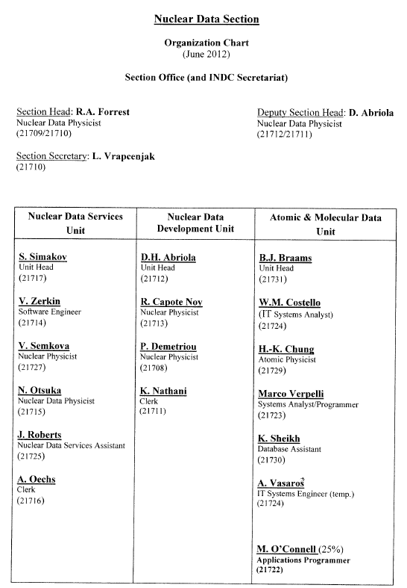
IAEA Nuclear Data Section
Three Units
17 staff

Slide 3
IAEA’s Nuclear Data Program
IAEA Activities Relating to NSDD
Coordinated Research Projects (CRPs)
ENSDF evaluations
Financial support for ENSDF evaluators
and horizontal evaluation/compilation activities
Coordination of the NSDD network
Workshops
Dissemination

Slide 4
Nuclear Data Projects – Status, Nov 2012
Nuclear Data Development
Coordinated Research Projects
  4 completed
  6 active
Data Development Projects + additional tasks
  11 active

Slide 5
CRPs related to NSDD
  Nuclear data for charged-particle monitor reactions and medical isotope production
  Beta-delayed neutron emission

Slide 6
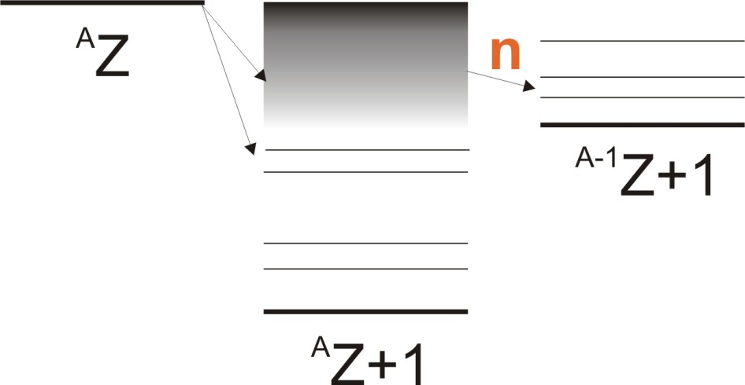
Beta-delayed neutron emission evaluation
S_{n}< Q_{β}
Precursor→
S_{n}
Important nuclear structure information
P_{n} : β-strength above S_{n}
t_{1/2}(^{A}Z+1): sensitive to low-lying β-strength

Slide 7
Beta-delayed neutron emission evaluation (2013-2017) D. Abriola
Motivation:
Beta-delayed neutrons are important for energy production, astrophysics and nuclear theory
Most of the data available are from precursors coming from fission fragments
New experimental facilities are available which will be able to produce new precursors in the neutron-rich region
Last evaluation with theoretical comparisons is from 2002
There is no database that compiles all relevant data

Slide 8
Beta-delayed neutron emission evaluation
Participants in CRP
USA (x 2) CANADA SPAIN (x 2)
FRANCE CHINA RUSSIA

Slide 9
Beta-delayed neutron emission evaluation
Objectives:
To create a reference database of evaluated data for beta-delayed neutron emission
The database should contain evaluated half-lives, emission probabilities and neutron spectra for individual precursors.
The evaluation methodology should be described
Agregate quantities like group values should be derived and stored in the database
The CRP should produce a priority list for evaluations and new experiments and improvements in the theoretical predictions

Slide 10
Beta-delayed neutron emission evaluation
Outputs:
Priority list for measurements
Database of evaluated data (format should be defined)
Old and New measurements compiled into database
Agregate quantities like group values stored in the database
Technical report

Slide 11
NSDD activities in the IAEA
ENSDF evaluations (D. Abriola )
Update of most neutron deficient nuclides of A=148 (with B. Singh)
ICTP exercise A=211
ENSDD-2012 exercise A=215
Mass chain A=144 to be submitted (with A. Sonzogni)

Slide 12
6+2+2 Contracts – 2011…2012
1. Joshi and Jain (India)
2. Wang and Audi (China) Atomic Mass Evaluation (Horizontal)
Zuber (Poland)
A. Negret (Romania)

Slide 13
5. J. Timar – Z. Elekes (Hungary)
6. N. Stone (USA)
Nuclear Moments (Horizontal):
Compilation and evaluation
7. Lalkovski (Bulgaria)
8. Abusaleem Kalifeh (Jordan)
9. S. Erturk (Turkey 2012)
10. Sukhjeet Singh DHINDSA (India 2012)

Slide 14
International Network of NSDD evaluators
NSDD NETWORK
Biennial meetings of the International Network of Nuclear Structure and Decay Data Evaluators (NSDD) are funded and organized under the auspices of NDS
The 19th meeting of NSDD network was held at the IAEA Vienna, Austria, 4–8 April 2011 (INDC(NDS)-0595). This meeting was attended by 35 scientists from 20 Member States

Slide 15
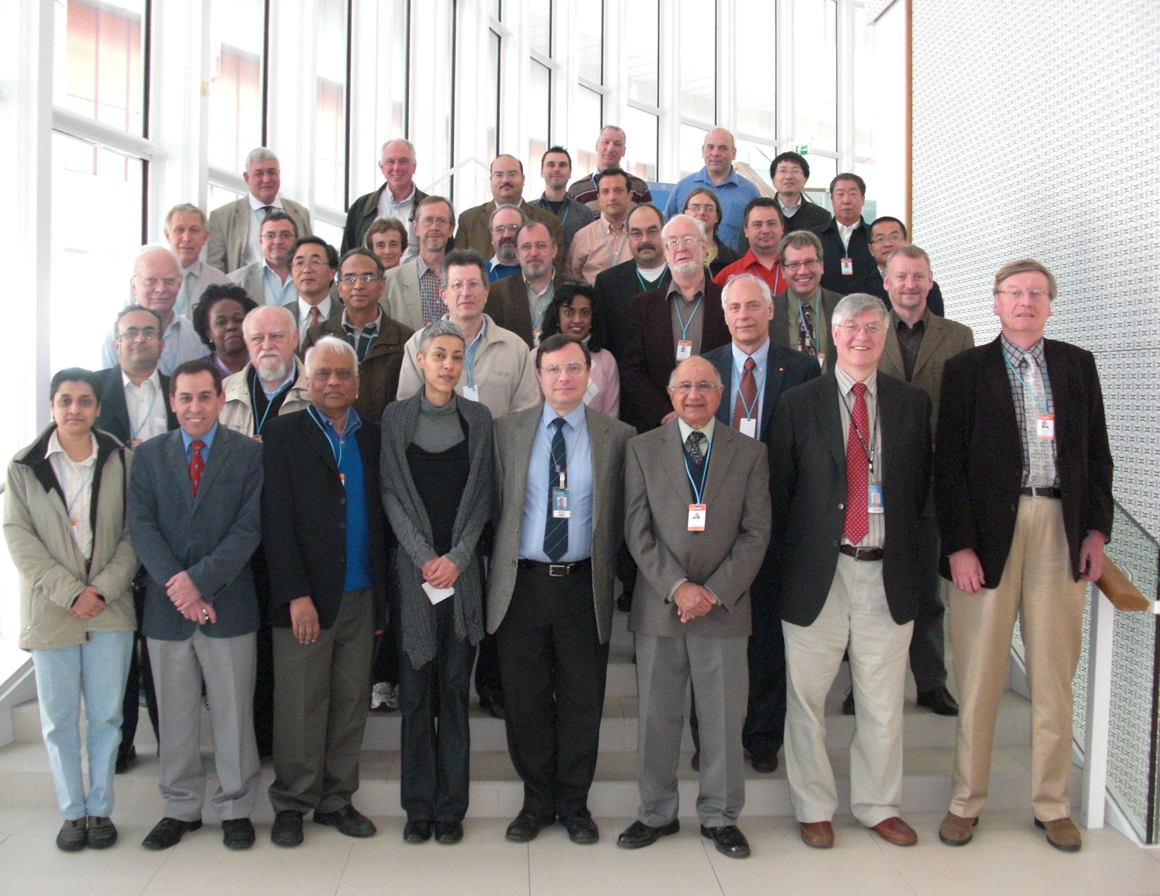
International Network of NSDD evaluators
NSDD NETWORK

Slide 16
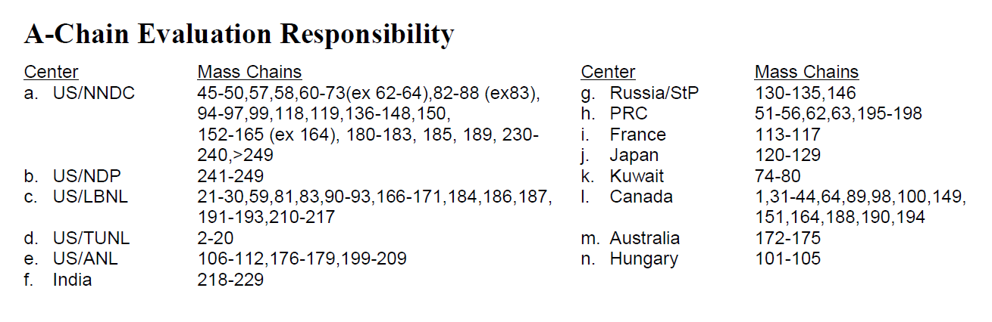
International Network of NSDD evaluators
NSDD NETWORK
14 Centres

Slide 17
International Network of NSDD evaluators
NSDD NETWORK
Specific mass chain activities, horizontal evaluations and technical issues
Problems are still being experienced in maintaining suitable numbers of mass chain evaluators (expressed as FTE – Full Time Effort)
Thanks to IAEA efforts, evaluators are being supported and are actively performing evaluations
NDS staff will continue to support new evaluators and collaborate in mass chain evaluations

Slide 18
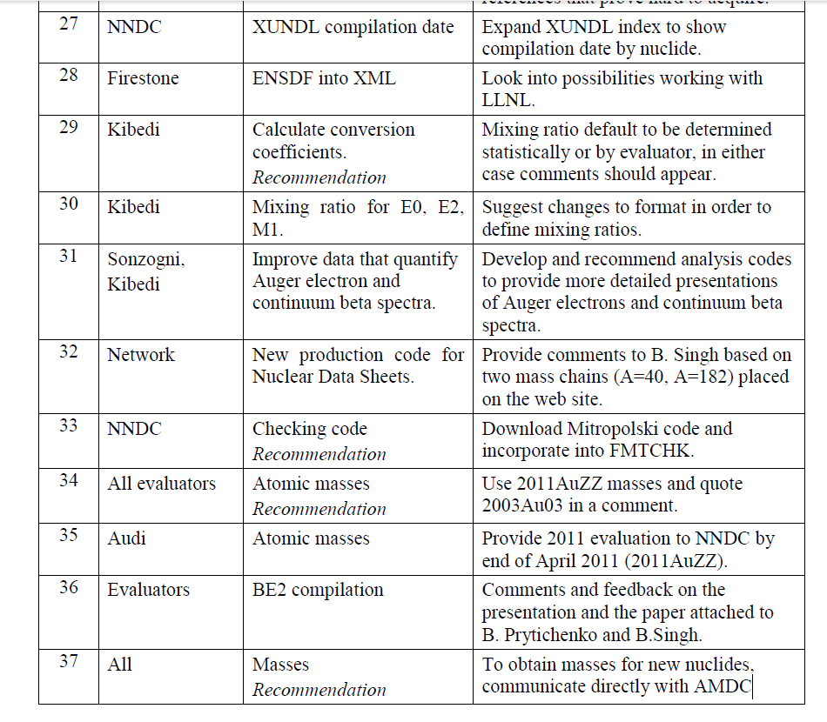
International Network of NSDD evaluators
NSDD NETWORK
List of 51 actions

Slide 19
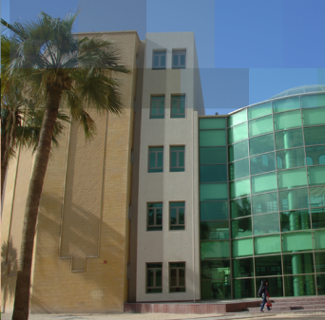

International Network of NSDD evaluators
20th meeting in Kuwait, January 2013
http://www-nds.iaea.org/nsdd/#int
KFAS &
Physics Department K.U.

Slide 20
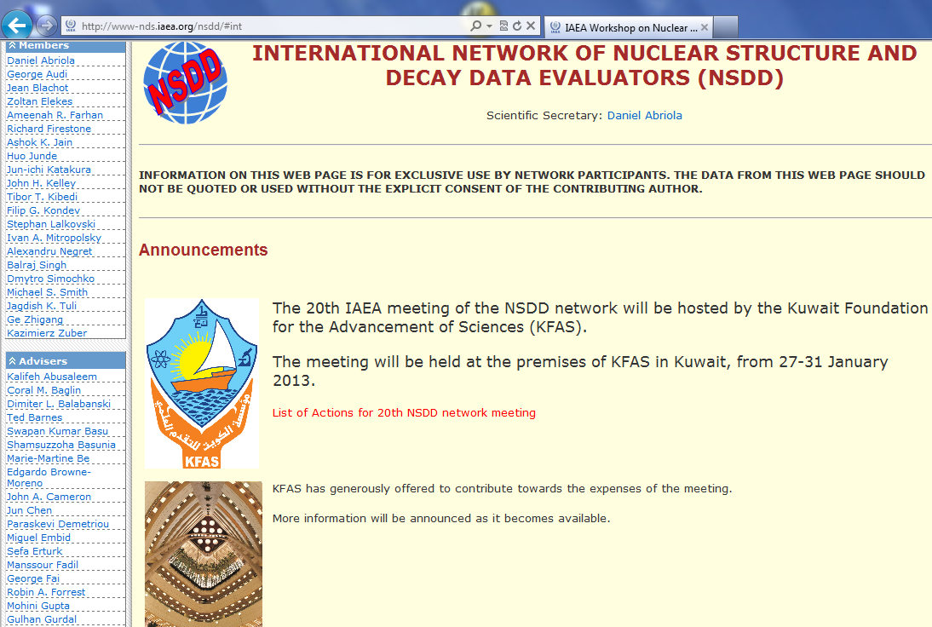

Slide 21
International Network of NSDD evaluators
NSDD NETWORK
Bilateral visits :
B. Singh, McMaster University to NDS. Collaborate on the update of the most neutron deficient nuclides of A=148: 148Tm, 148Er and 148Ho for ENSDF database. 14–16 June 2011
D.H. Abriola (IAEA-NDS) to McMaster University. Collaborative work with B. Singh on beta-delayed neutron emission evaluation. 7–11 November 2011
D.H. Abriola (IAEA-NDS) to NNDC. Attendance at USNDP meeting, and carry out ENSDF work. 13–23 November 2011
B. Pritychenko, NNDC to NDS. Install and load NSR database on NDS MySQL database server and revise technical procedures. 21–25 November 2011

Slide 22
International Network of NSDD evaluators
NSDD NETWORK
Bilateral visits (cont):
F. Kondev, ANL to NDS. Collaborate on the improving of LiveChart. Decay Data sets, Radlist and XUNDL 19–20 March 2012
A. Sonzogni (NNDC to NDS) Instal NuDat, ENSDF web retrival. Synchronize NSD-NNDC. 26–30 March 2012
P. Dimitriou (IAEA-NDS to Laboratoire National de Métrologie et d’Essais (LNE) DDEP 8-10 Oct. 2012
D.H. Abriola (IAEA-NDS) to NNDC. Attendance at USNDP meeting, and carry out ENSDF work. 5–9 November 2012

Slide 23


Workshops 2012
Nuclear Structure and Decay Data: Theory and Evaluation, ICTP, Trieste, 6-17 August 2012 Joint IAEA-ICTP
Workshop Directors: J.K. Tuli, D.Abriola
Topics
ENSDF evaluation philosophy and analysis programs
NSDD network, relevant IAEA activities, access to appropriate web pages and Nuclear Reactions
Nuclear models
Radioactive Decays
Adopted Levels
Databases and Web resources

Slide 24
Workshops 2012
1. Nuclear Structure and Decay Data: Theory and Evaluation, ICTP, Trieste, August 2012 Joint IAEA-ICTP
Topics
Ten lecturers, delivered a two-week course to
24 participants from
16 countries
Lectures were presented during mornings while afternoons were dedicated to training sessions with practical evaluation activities:
six student groups
B. Singh was the main organizer of the Workshop activities:
Mass A=211 (see B.Singh)

Slide 25
Workshop on NSDD: theory and evaluation

Slide 26
Workshop on NSDD: theory and evaluation

Slide 27
Workshop on NSDD: theory and evaluation

Slide 28
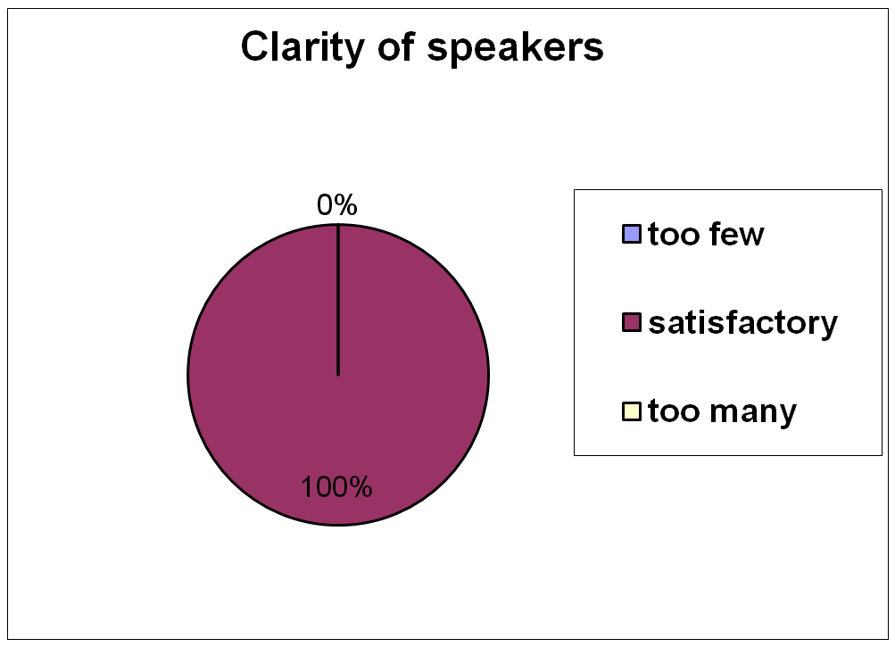
Workshop on NSDD: theory and evaluation

Slide 29
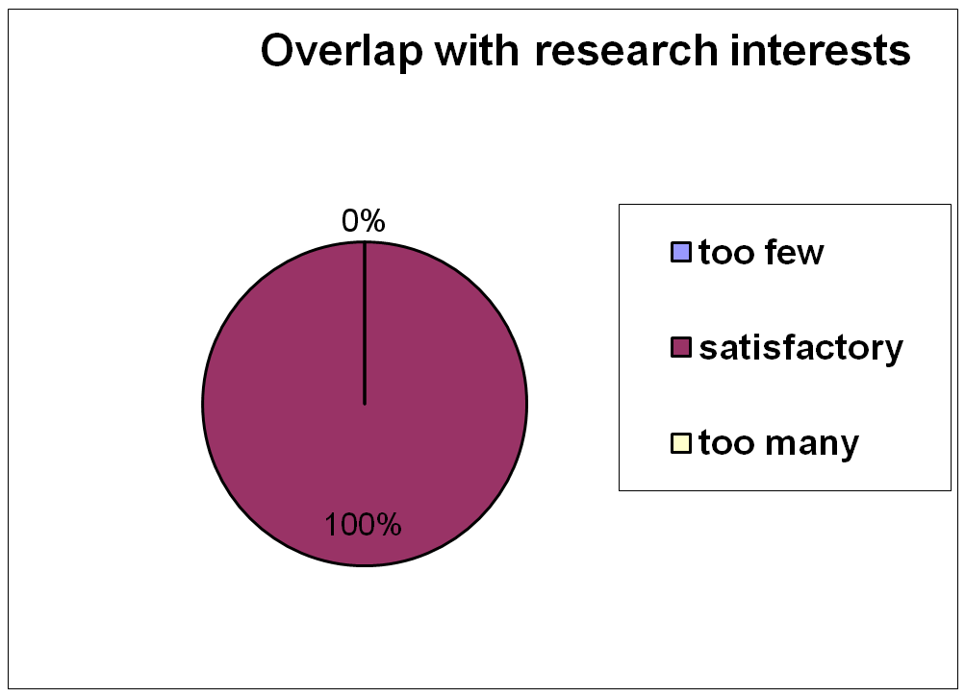
Workshop on NSDD: theory and evaluation

Slide 30
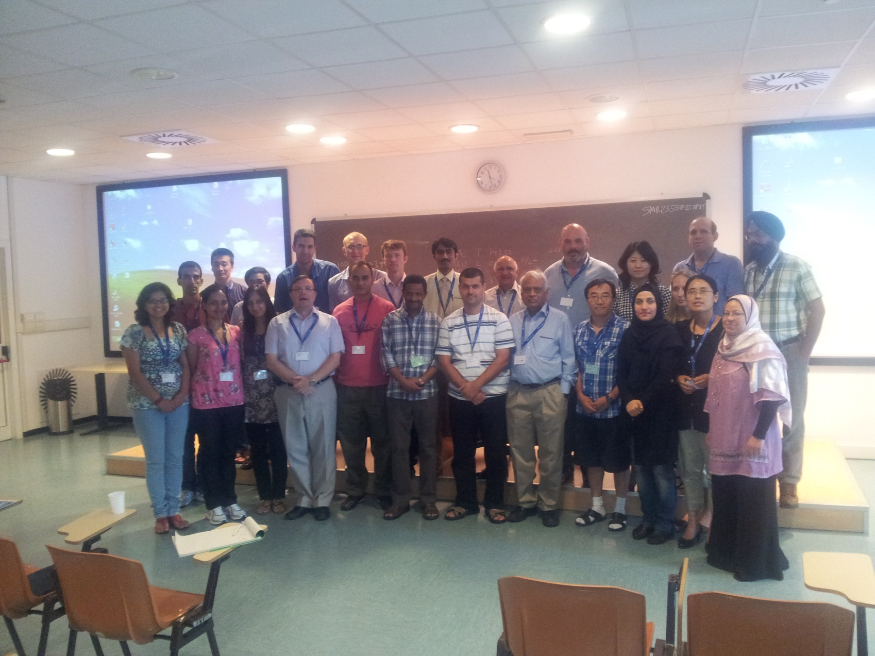
Workshop on NSDD: theory and evaluation

Slide 31
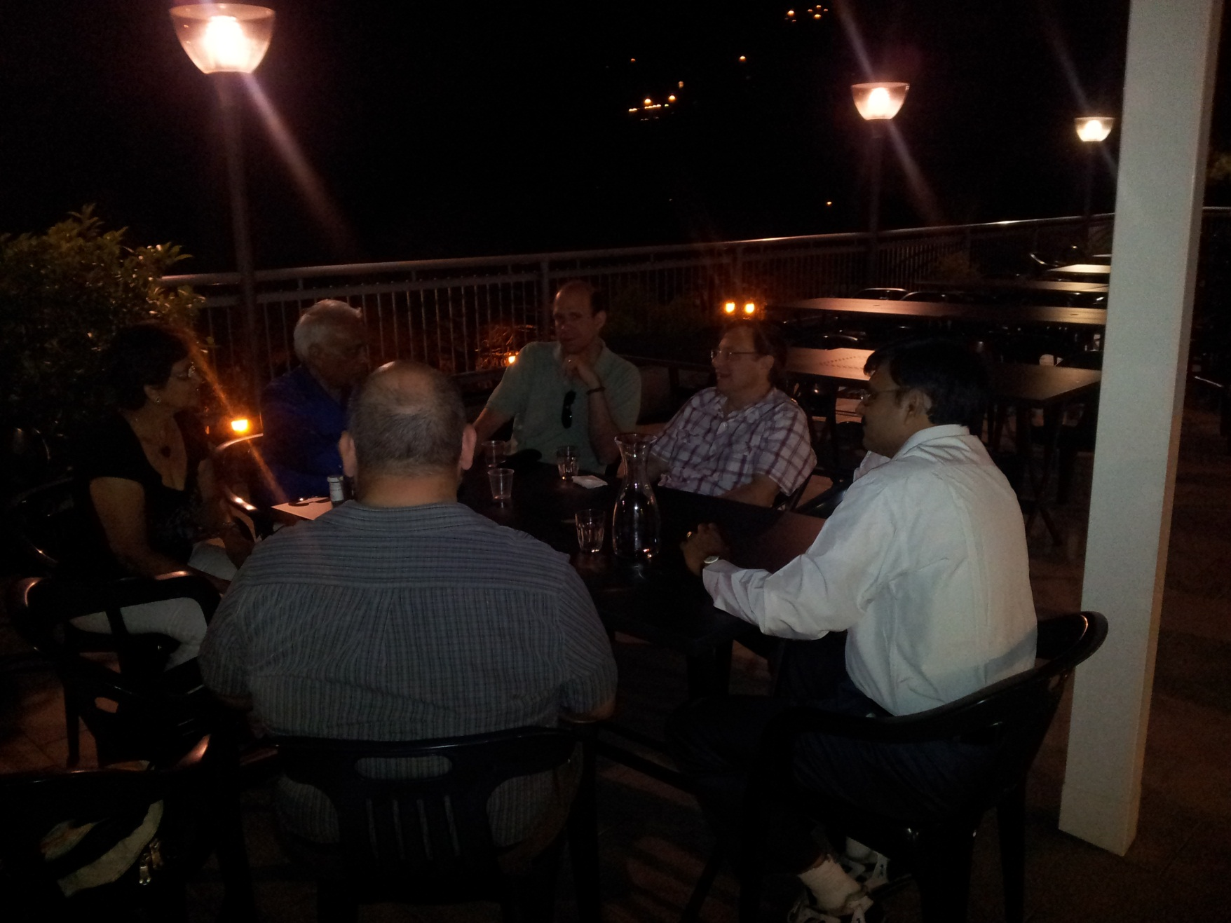
Workshop on NSDD: theory and evaluation

Slide 32
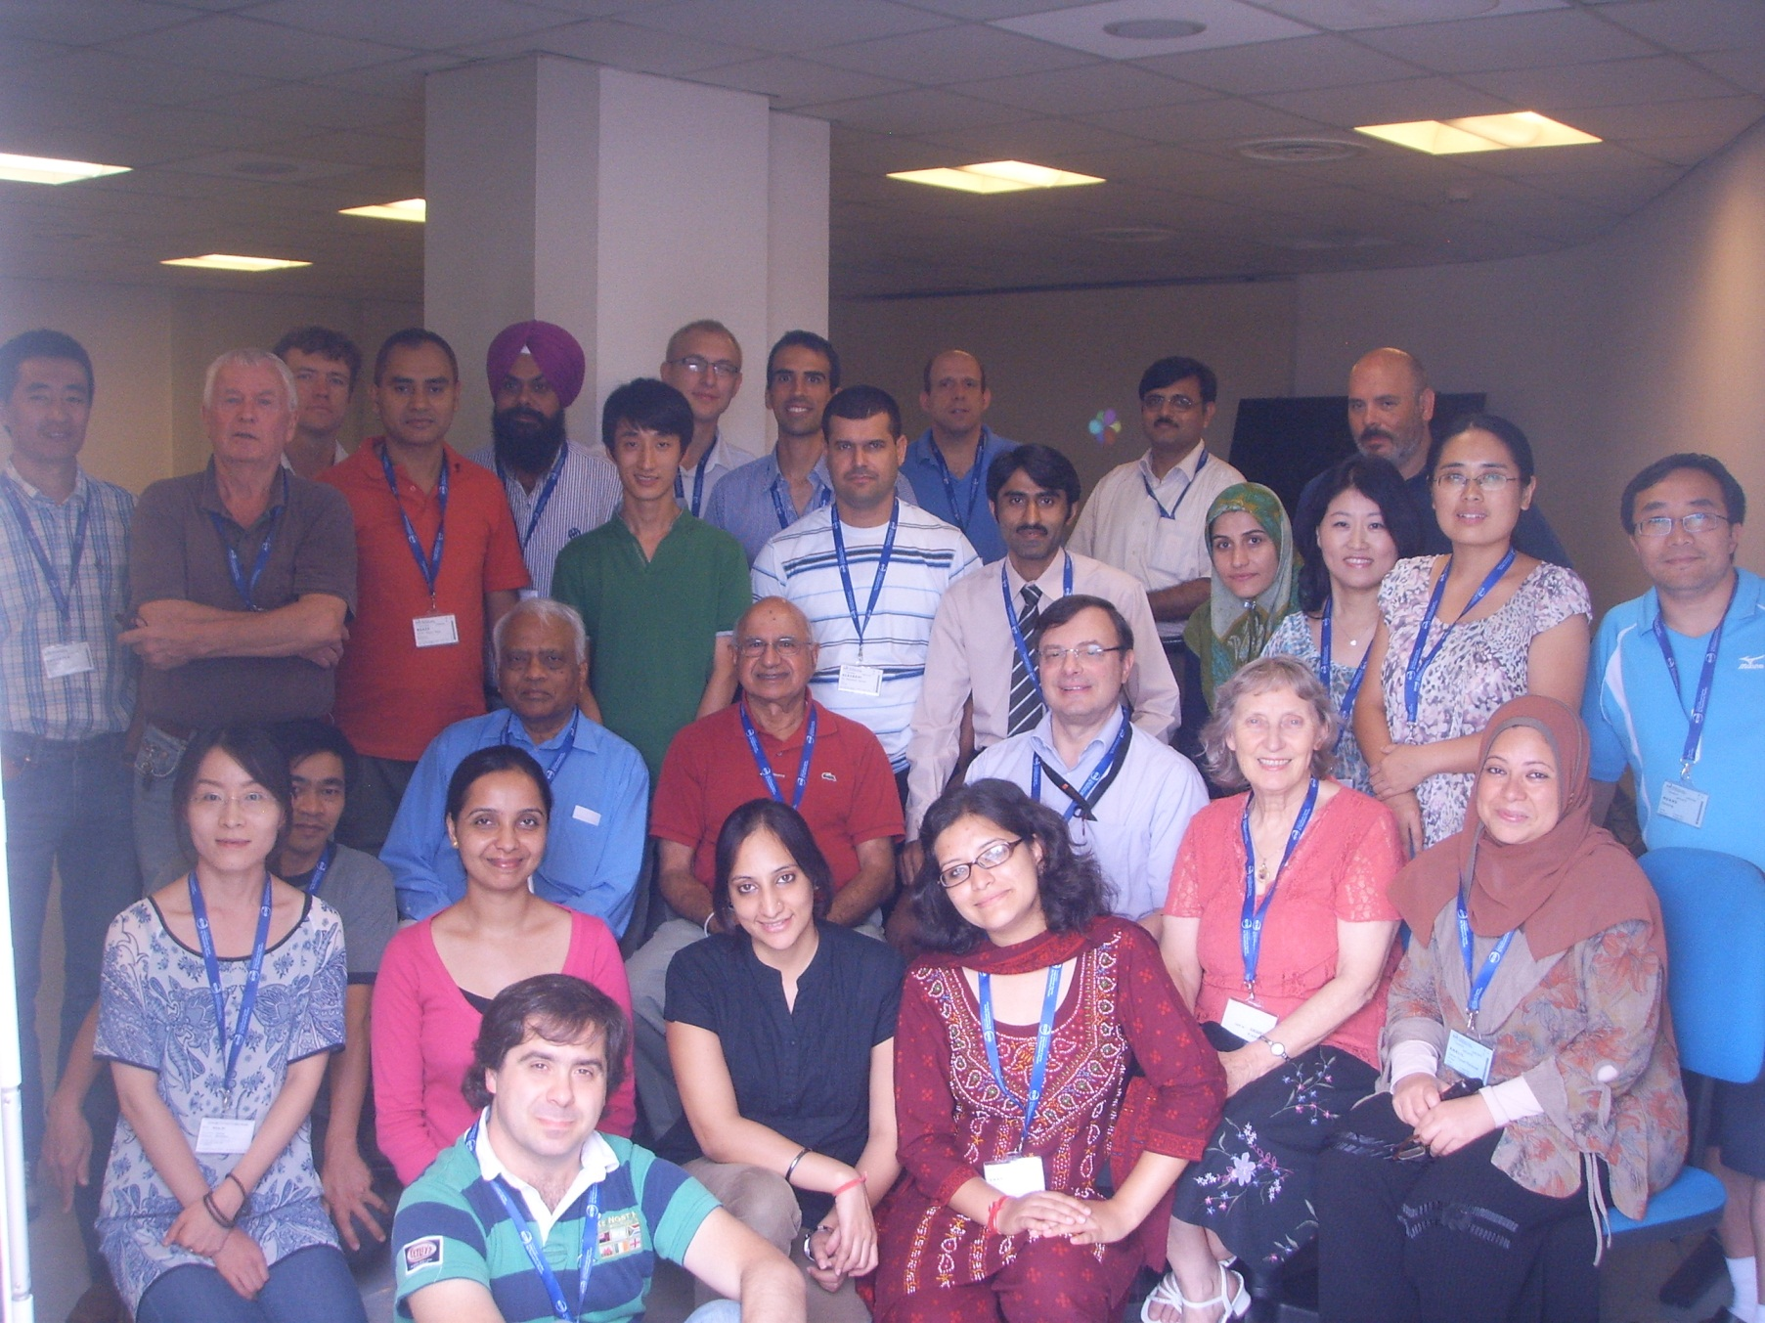
Workshop on NSDD: theory and evaluation

Slide 33
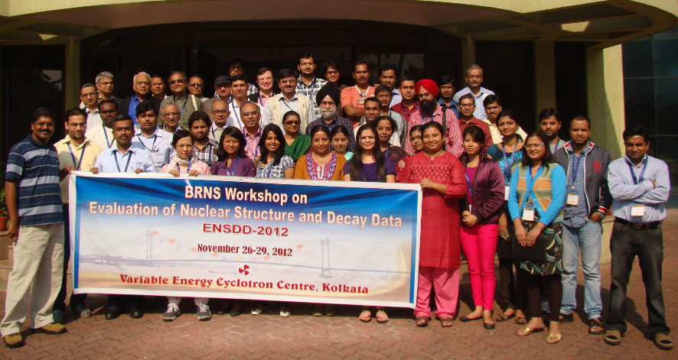
Workshops 2012
1. ENSDD-2012 VECC, Kolkata, Nov 26-29 2012 BRNS
36 participants, 5 student groups
B. Singh was the main organizer of the Workshop activities:
Mass A=215 (All groups to submit by 31 January 2013 to B.Singh)

Slide 34
Workshop 2014
x. Nuclear Structure and Decay Data: Theory and Evaluation….
Workshop Directors: ?

Slide 35
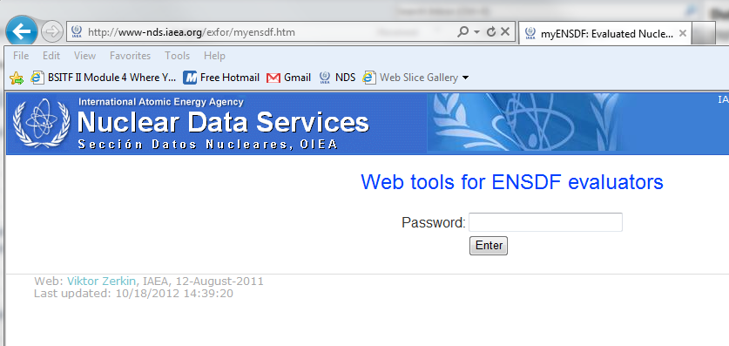
Pass: nsdd123$
Dissemination

Slide 36
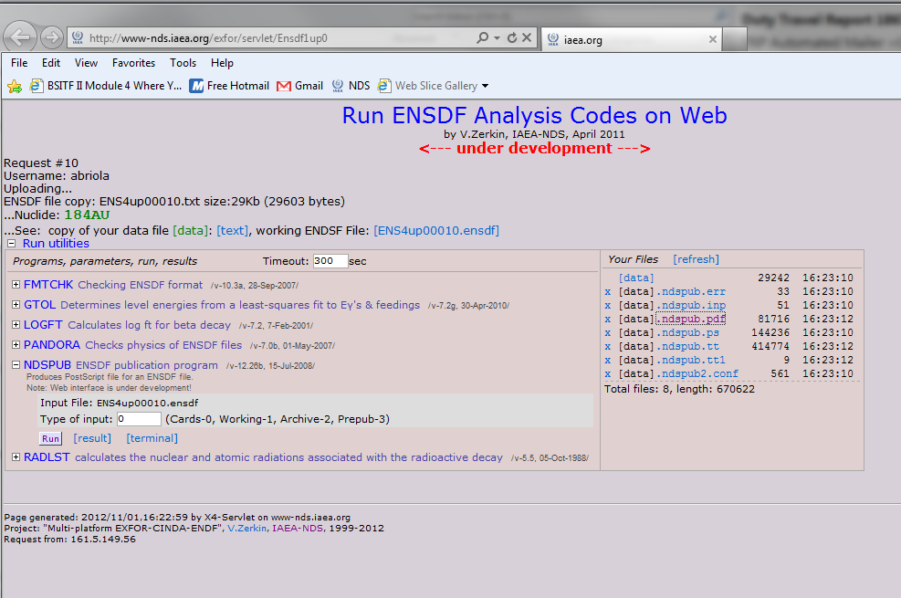
Nuclear Data Projects – Status, Nov 2011
Dissemination

Slide 37
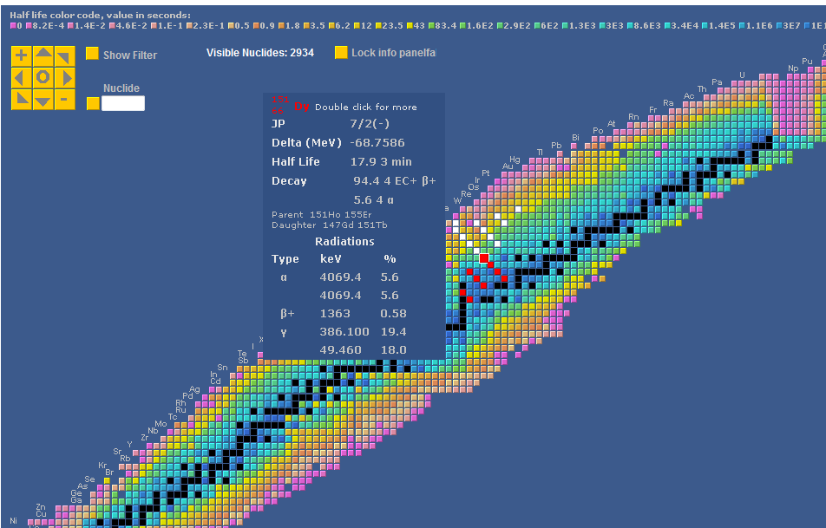
Livechart display
nuclide data on
mouse-over
single selection
zooming and moving
parents – daughters
chain (white - red)
Data sources: ENSDF + Radlist, NWC, Atlas of Neutron Resonance

Slide 38
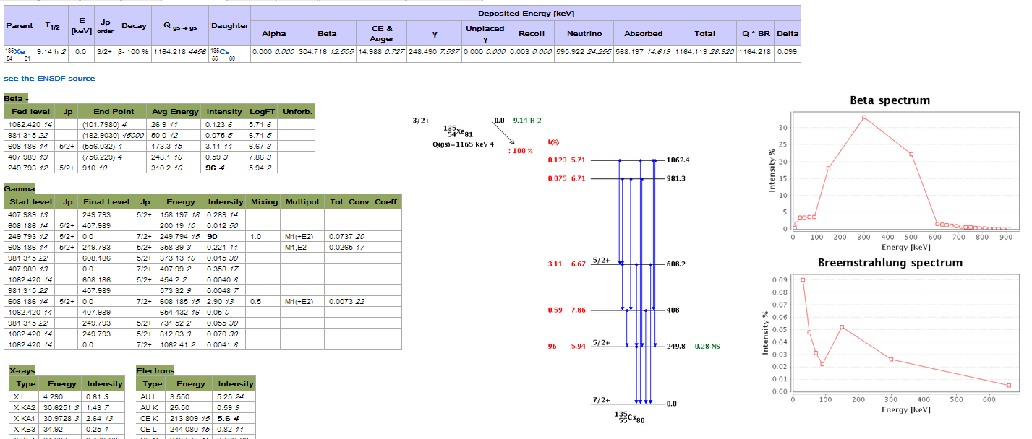
All ENSDF decay datasets parsed in a relational database.
Web-page display overview
Deposited energy, β and Breemstrahlung spectra
Schema plotting
Details for
β- , β+, EC, α, ϒ, electrons, X-ray

Slide 39
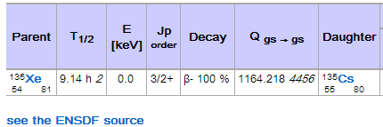
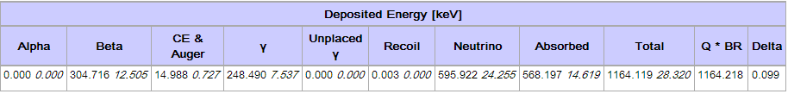
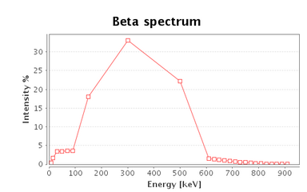
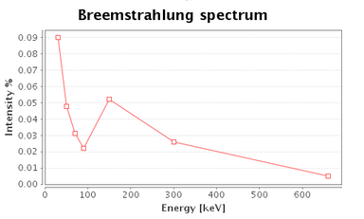
Detail of the web page content
Decay info - Q from AMDC 2011.
Link to the ENSDF source
Deposited energy,
Β, and breemstr.
from Radlist

Slide 40
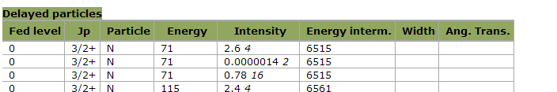





Detail of the web page content
Full detail for each radiation type.
Circled are the info not available in the previous version

Slide 41
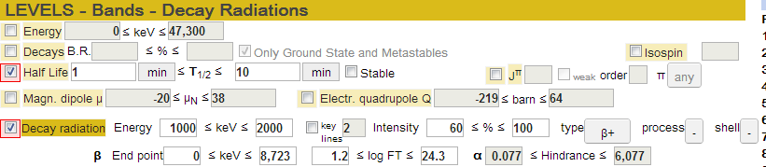
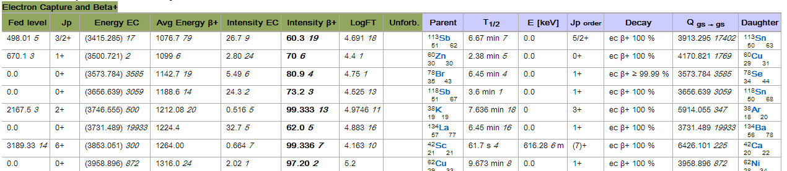
Examples of queries
Nuclear medicine: e+ emissions with filter on half-life, energy, and intensity

Slide 42

Thank you

